Slide 1
What’s a decolonised Christmas?
An inclusive celebration?
An erudite celebration?
An international celebration?
A spiritual celebration?
A commercial celebration?
A familial celebration?
A universal celebration?

Slide 2
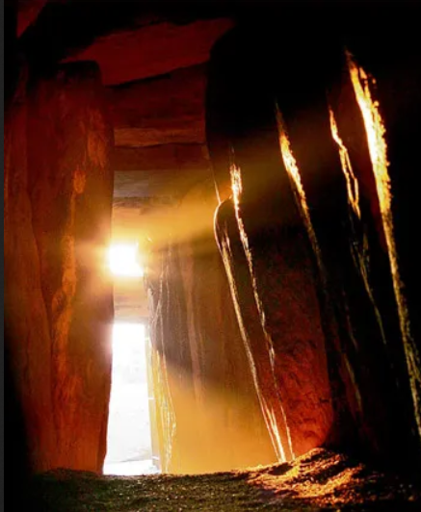
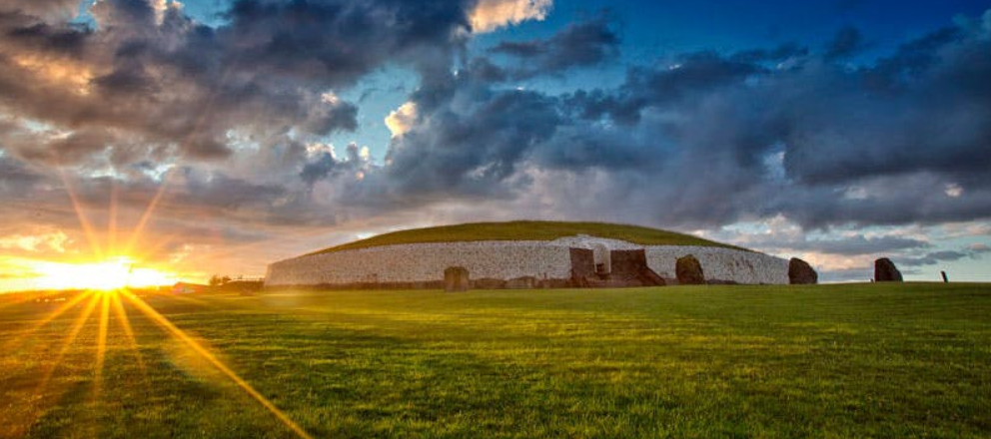
Neolithic roots
From early celebration of lights and fire to Celtic belief systems and folklore

Slide 3
Before Christianity
Neolithic people built mounds or tombs with corridors the design of which would align with winter sun rays only once a year, on the winter solstice to create a passageway leading to the beyond. (e.g. Newgrange Stone Age passage tomb in Ireland).
In pre-Celtic minds, thousands of years before Jesus Christ, the longest night on the 21st of December was paradoxically the only time when one could enter in direct communication with the realm of the spirits.
Later, according to Celtic myth, the solstice marked a great battle between the Oak King who represented the light, and the Holly King who represented darkness. Eventually the Oak King would be victorious at the winter solstice, and daylight would slowly return to the land until it was time to do battle again, on the 21st of June at the summer solstice.
Druids revered the mistletoe plant as ‘ever green’, which signified continued life over the cold dark winter. It was also believed to have aphrodisiac properties hence the association with a chaste kiss. We still use it to this day.
The winter solstice would be the occasion to make a great feast, butcher some animals and enjoy the harvest before the harshest winter months came. It was not a rare occurrence to lose family members due to malnutrition in the winter months (from January to April) when food was scarce. To light fires in the night was a way to repel the evil spirits and appeal to the gods for protection.
When the Romans expanded their empire over Northern Europe, they decided to extend their Saturnials (which happened in early December) to the Pagan celebrations at the end of the December months. The idea of a banquet became popular and early Europeans started exchanging gifts.
We are familiar with wreaths worn on the crown of famous political heads in Ancient Greece and Rome to adorn the powerful and morally righteous, we might not realise the practice was also common in Ancient Egypt and amongst the Jews to decorate homes for religious purposes such as weddings or the two-day Spring festival of Shavuot.
The wreaths promoted the harvest and the blessings of nature and the richness of the soil.
It appears that Christmas is a celebration rooted in agriculture and the passing of seasons. It could be argued that it is deeply connected to natural elements mostly: wood, fire (light and sun) and earth.
When Christianity spread over Europe, someone, unknown to us, decided that Jesus Christ’s date of birth would coincide with early pagan celebrations of the winter solstice. This was a very clever decision since it allowed Christianity to reappropriate this popular event and shape it in a biblical way. The nativity became fundamental to the celebration. It was indeed a relatable event with the positive rejoicing at a baby’s birth. Using the advent calendar, the three Kings, the epiphany and all these dates to punctuate the year in order to rearrange the lives of Christians, Christmas lost its strong pagan flavours.

Slide 4
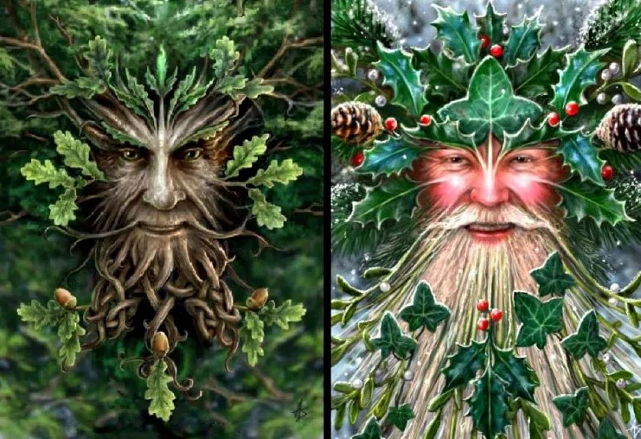
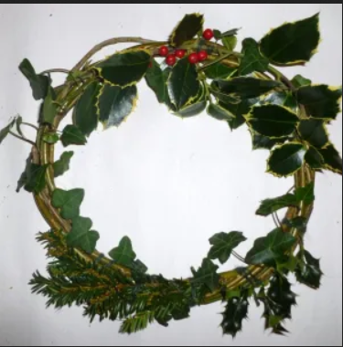
Forest School Christmas
The Gods of Solstice and Yule: Oak and Holly

Slide 5
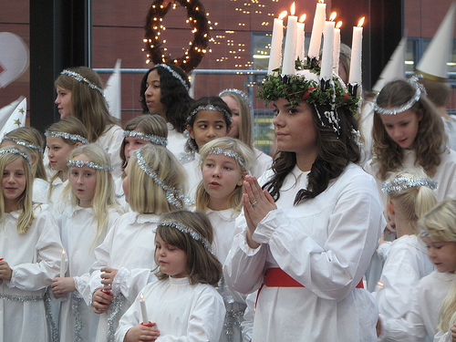
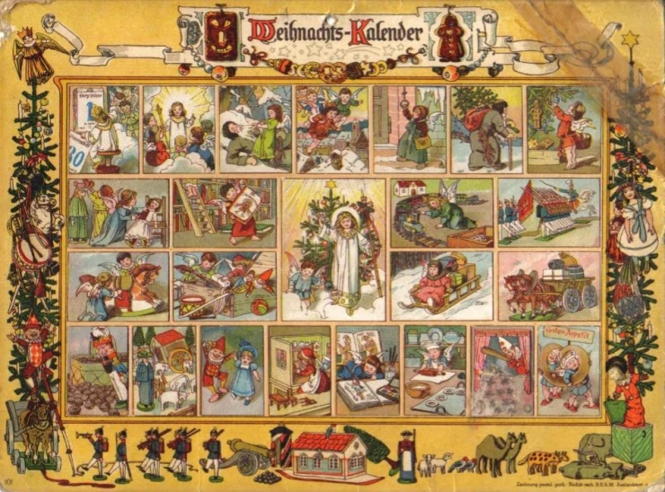
Germanic and Scandinavian roots
Etymology. From Middle English yol, from Old English ġeōl, ġeola (“Christmastide, midwinter”), either cognate with or from Old Norse jól, from Proto-Germanic *jehwlą, from Proto-Indo-European *yekə- (“joke, play”), related to Proto-Indo-European *yek- (“to speak, utter”).

Slide 6
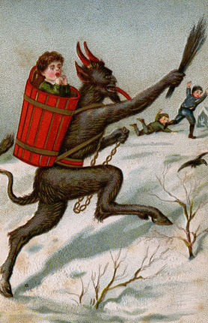
Scary Christmas Krampus in Germanic countries

Slide 7
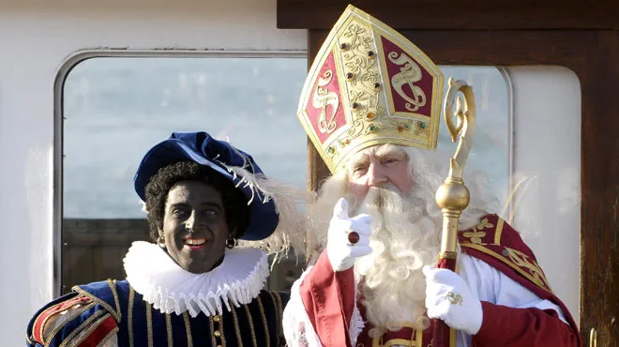
L’annulation du père fouettard à Utrecht en Hollande en 2015
https://www.rtl.be/info/monde/europe/plus-de-pere-fouettard-dans-les-ecoles-d-utrecht-nous-voulons-celebrer-saint-nicolas-d-une-maniere-respectueuse-pour-tous--759075.aspx
Racist Christmas
In the Netherlands

Slide 8
Raciste
Offensif
Terrible
Choquant
Hallucinant
Déplorable
Cynique
Traditionelle
démodé
Je pense que
Je trouve que
Je crois que
A mon avis
Selon moi
La photo est
La tradition est
La célébration est
Inconceivable en 2022.
Inacceptable
Incompréhensible
Impensable
Atroce
Horrible
ridicule
Parce que /
car
c’est

Slide 9
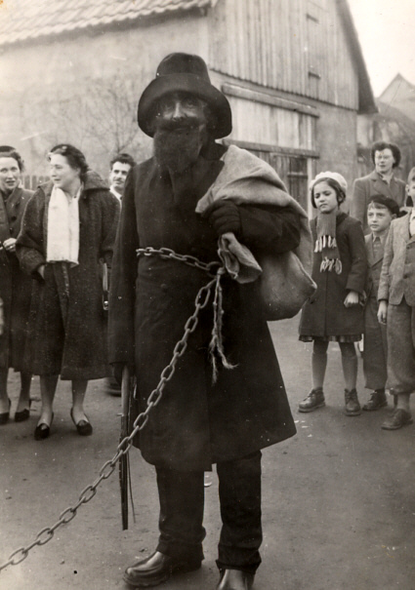
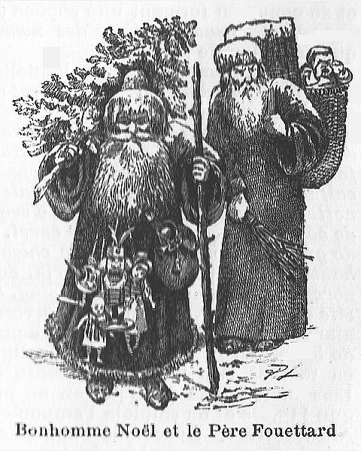
Les origines du Père Fouettard

Slide 10
Listen to the song about Saint Nicholas and Le Père Fouettard: La légende de Saint Nicolas. Fill in the gaps
https://youtu.be/3xEL0kRVq6I
Refrain: Ils étaient trois petits enfants Qui s'en allaient glaner aux champs. Tant sont allés tant sont venus, Que sur le 1)_ _ _ _ se sont perdus. S'en sont allés chez le _ _ _ _ _ _ _: Boucher voudrais-tu nous loger? Refrain: 2. Entrez, entrez 3) _ _ _ _ _ _ enfants Il y a d'la place assurément. Ils n'étaient pas sitôt entrés, Que le boucher les a tués. Refrain: 3. Saint Nicolas au bout d'sept ans Vint à 4) _ _ _ _ _ _ dedans ce champ, Alla frapper chez le boucher: Boucher 5) _ _ _ _ _ _ _ _ -tu me loger? Refrain: 4. Entrez, entrez, Saint Nicolas, Il y a d'la place, il n'en manqu' pas. Il n'était pas sitôt entré Qu'il a demandé à souper.
5. On lui apporte du 6) _ _ _ _ _ _ .
Il n'en veut pas, il n'est pas bon.
On lui apporte du rôti.
Il n'en veut pas il n'est pas cuit.
Refrain:
6. Du p'tit salé je veux avoir,
Qu'il y a sept ans qu'est au saloir.
Quand le boucher entendit ça,
Bien vivement il se sauva.
Refrain:
7. Petits enfants qui dormez là,
Je suis le grand 7) _ _ _ _ _ Nicolas.
Le grand saint étendit trois doigts,
Les 8) _ _ _ _ _ enfants ressuscita.
Refrain:
8. Le premier dit: J'ai bien 9) _ _ _ _ _ .
Le second dit: Et moi aussi.
A ajouté le plus petit:
Je croyais être en 10) _ _ _ _ _ _ _ .

Slide 11
A Victorian reinvention
In the Victorian times, Christmas was not so popular anymore. It corresponded to a simple religious mass without the banqueting and partying of mediaeval times. However, another phenomenon was slowly developing. This was the invention of the concept of childhood.
Before the enlightenment, children had been considered as little versions of adults. They were not treated differently. Many children were working, engaged in domestic roles and many girls would be married as soon as they became nubile.
The writings of philosophers such as Jean-Jacques Rousseau and John Locke raised the issue of childhood as a special time when humans are not fully developed and have different needs.
This change in perspective happened in many fields at once: In fashion, the patterns started to diversify and special clothes were created to fit children’s bodies. Scientific and medical discoveries highlighted the fact that children were not a miniature version of adults but at a specific stage of their development. Writers also started publishing books aimed at children as a specific group.
Father of four, with a fifth on the way, Charles Dickens wrote a ghost story, which became one of his most popular tales, A Christmas Carol in 1843.
Dickens was aware of the plight of poor children in cities, he had visited the ragged schools where charity workers hoped to educate the next generation and feed them. (often their only meal of the day). Dickens elected to broadcast the plight of the poor and celebrate the delights of family life in his writing.
It is striking to see how much of an impact this middle class family man has had on the way we perceive Christmas to this day; “Dickens, it may truly be said, is Christmas,” said the literature scholar VH Allemandy in 1921. However, Queen Victoria and her German spouse, Albert, also promoted the Germanic traditions of the decorated fir tree and Roman family exchange of presents by having their Christmas family scene on postcards in 1848. Albert would even decorate the tree himself.
“Christmas, I always look upon as a most dear happy time, also for Albert, who enjoyed it naturally still more in his happy home, which mine, certainly, as a child, was not. It is a pleasure to have this blessed festival associated with one’s happiest days. The very smell of the Christmas Trees of pleasant memories.”
Entry from Queen Victoria’s journal on 24 December 1841
The middle classes were quick to follow. Thus another influential group started using the winter solstice celebrations to promote their personal power _ the monarchy and the British Empire.

Slide 12
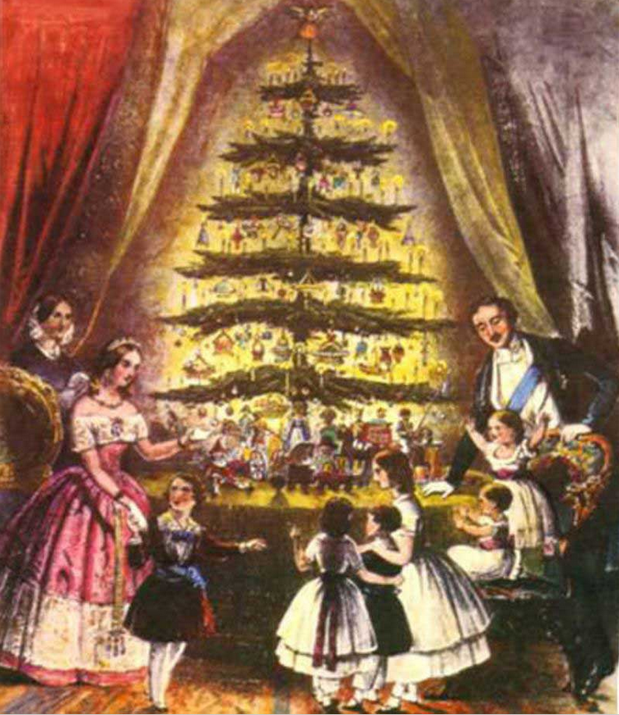
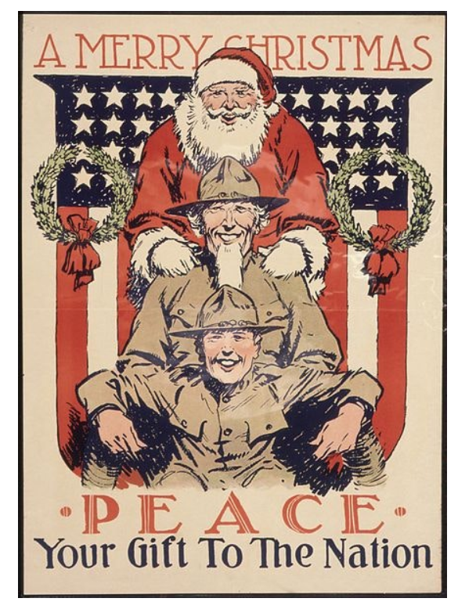
Political Christmas
Victoria and Albert’s Christmas card
WWI Santa

Slide 13
As the British Empire was slowly entering its phasis of decline, another empire reached its climax. The American empire with its foundation of WASP culture imported from Europe, its expansionism and appropriation of local indigenous cultures (the use of turkey instead of roast chicken) and its triumphant consumerism.
Since the end of the Second World War, Christmas has become a capitalist venture, a highlight of the shopkeepers’ and global corporations’ yearly income.
From movies on Netflix to pyjamas, to dog blankets to biscuit tins, every product gets a Christmas makeover. It is getting harder every year to discern the spiritual roots of the neolithic winter celebration. Christmas still manages to fill churches with once-a-year faithfuls but it is definitely no longer its ‘raison d’être’.
Making money is at the cornerstone of our contemporary Christmas.
Yet Christmas remains an occasion for the family to unite and celebrate together if not always in harmony. Japanese families celebrate Christmas by going to eat at McDonalds and people in the West Indies still take the time to bake a Caribbean black cake soaked in rum as early as in November.
During the pandemic, the lockdown also highlighted how important “driving home for Christmas” still is.
So what would a decolonised Christmas look like? This is a difficult question to answer since Christmas is a concretion of habits and traditions pertaining to multiple faiths, regions and cultures, stemming from many different eras. I would argue that its name is its most religious aspect left but one can’t forget that its roots remain deeply pagan and as ancient as the stones of Stonehenge.
Christmas is indeed a neolithic event.
To go back to its most ancient roots would make for a simple evening of roasting meat, burning pyres to rid oneself of bad luck, singing whilst wearing mistletoe and holly wreaths. Visiting an early burial mound in Ireland or Denmark might also fit the bill.

Slide 14
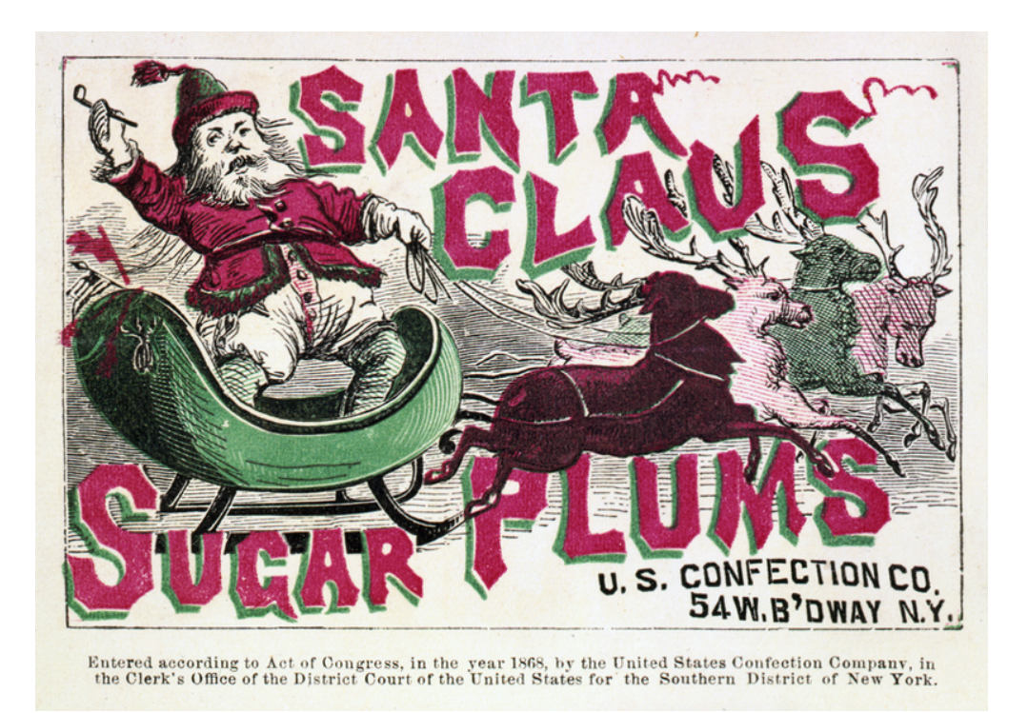
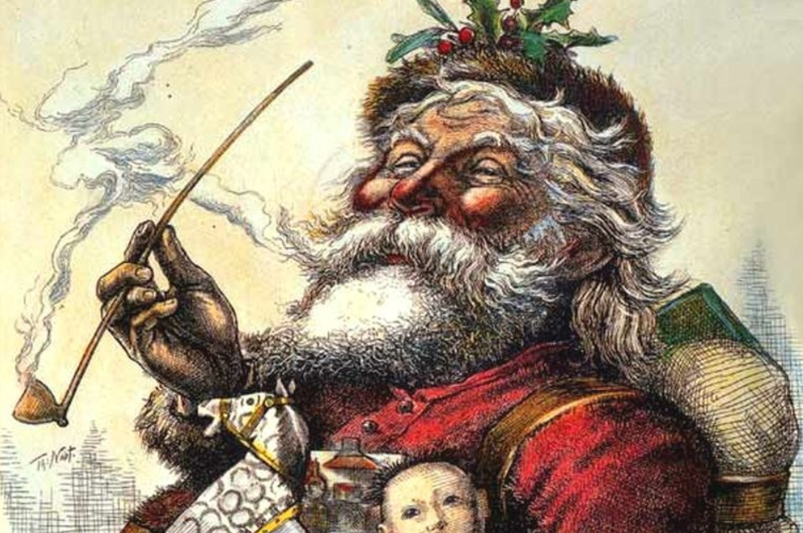
Capitalist Christmas

Slide 15
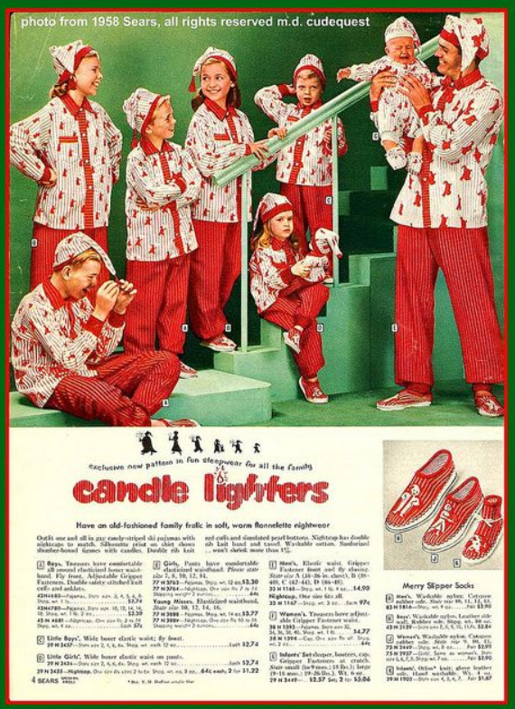
Kitsch Christmas

Slide 16
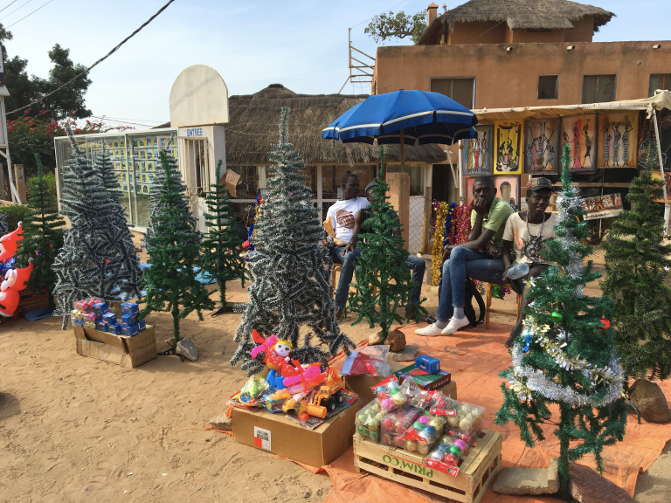
A Reappropriation of Christmas all around the world
A market stall in Mbour, Senegal where the seller is offering Christmas tree and decorations
Christmas tree in La Martinique, a French colony the economy of which is based on exporting bananas to Europe
https://i0.wp.com/www.markandjim.com/wp-content/uploads/2015/12/IMG_0819_Fotor.jpg

Slide 17
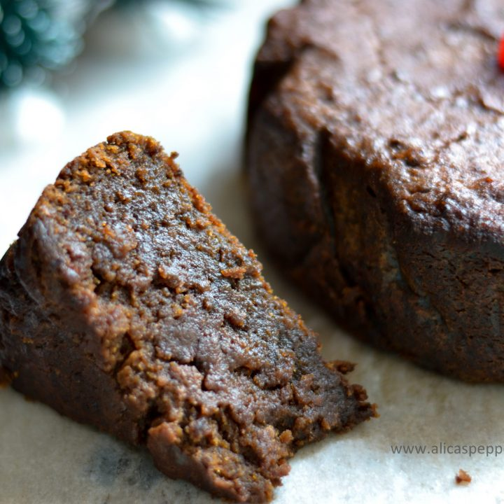
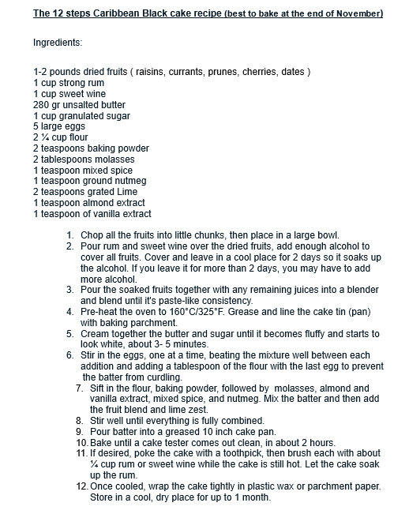
West Indian and Creole Christmas

Slide 18
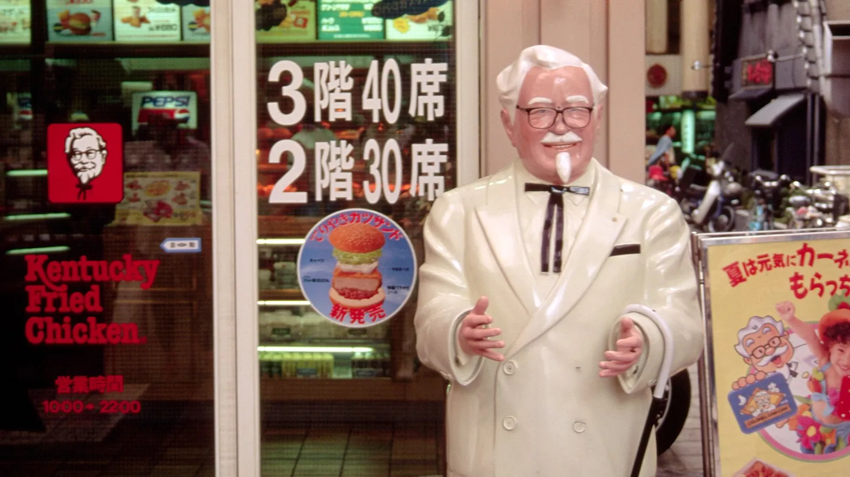
Fun fact:
Christmas is a dating event in Japan whereas New Year’s Eve is for the family.
The popular fast-food restaurant, Kentucky Fried Chicken (KFC), is a national favorite in Japan at Christmas. According to the BBC, an estimated 3.6 million Japanese families celebrate with KFC on Christmas.

